Slide 1
Metatranscriptomics
Dr. Natalia Zajac
Metagenomics, 12.2024

Slide 2
Overview
What is metatranscriptomics - how does it relate to RNAseq and how does it differ from metagenomics?
Processing of reads and statistical analysis
Quality filtering
Assembly/Mapping to databases
Functional and taxonomic annotation
Visualization
Research questions and case studies

Slide 3
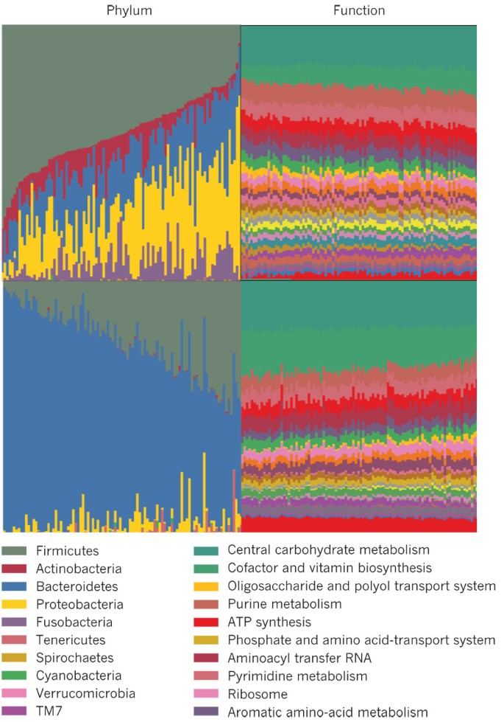
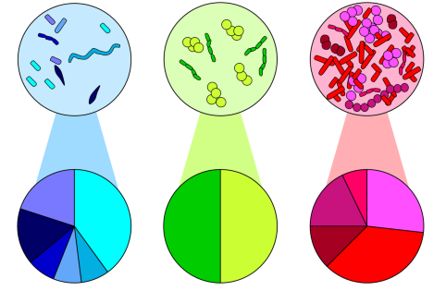
What is metatranscriptomics?
16S rRNA can tell us WHO IS THERE?
But is what you see a cause or consequence?
Claassen-Weitz et al. 2020
Metatranscriptomics can tell us WHO IS DOING WHAT? – microbiome activity
Shotgun metagenomics can tell us WHO IS THERE? And WHAT IS THEIR FUNCTIONAL POTENTIAL?
https://www.nature.com/articles/nature11550

Slide 4
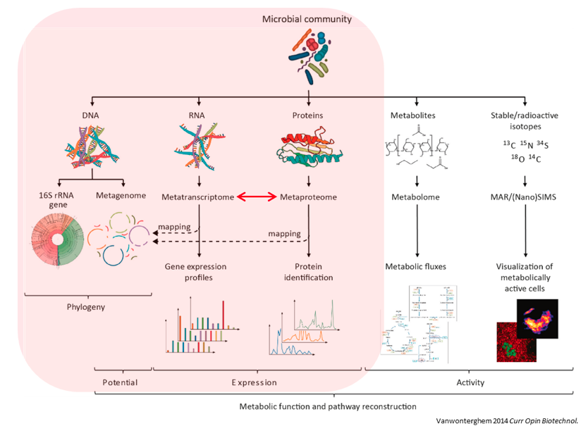
What is metatranscriptomics?
https://training.galaxyproject.org/training-material/topics/microbiome/tutorials/metatranscriptomics/tutorial.html

Slide 5
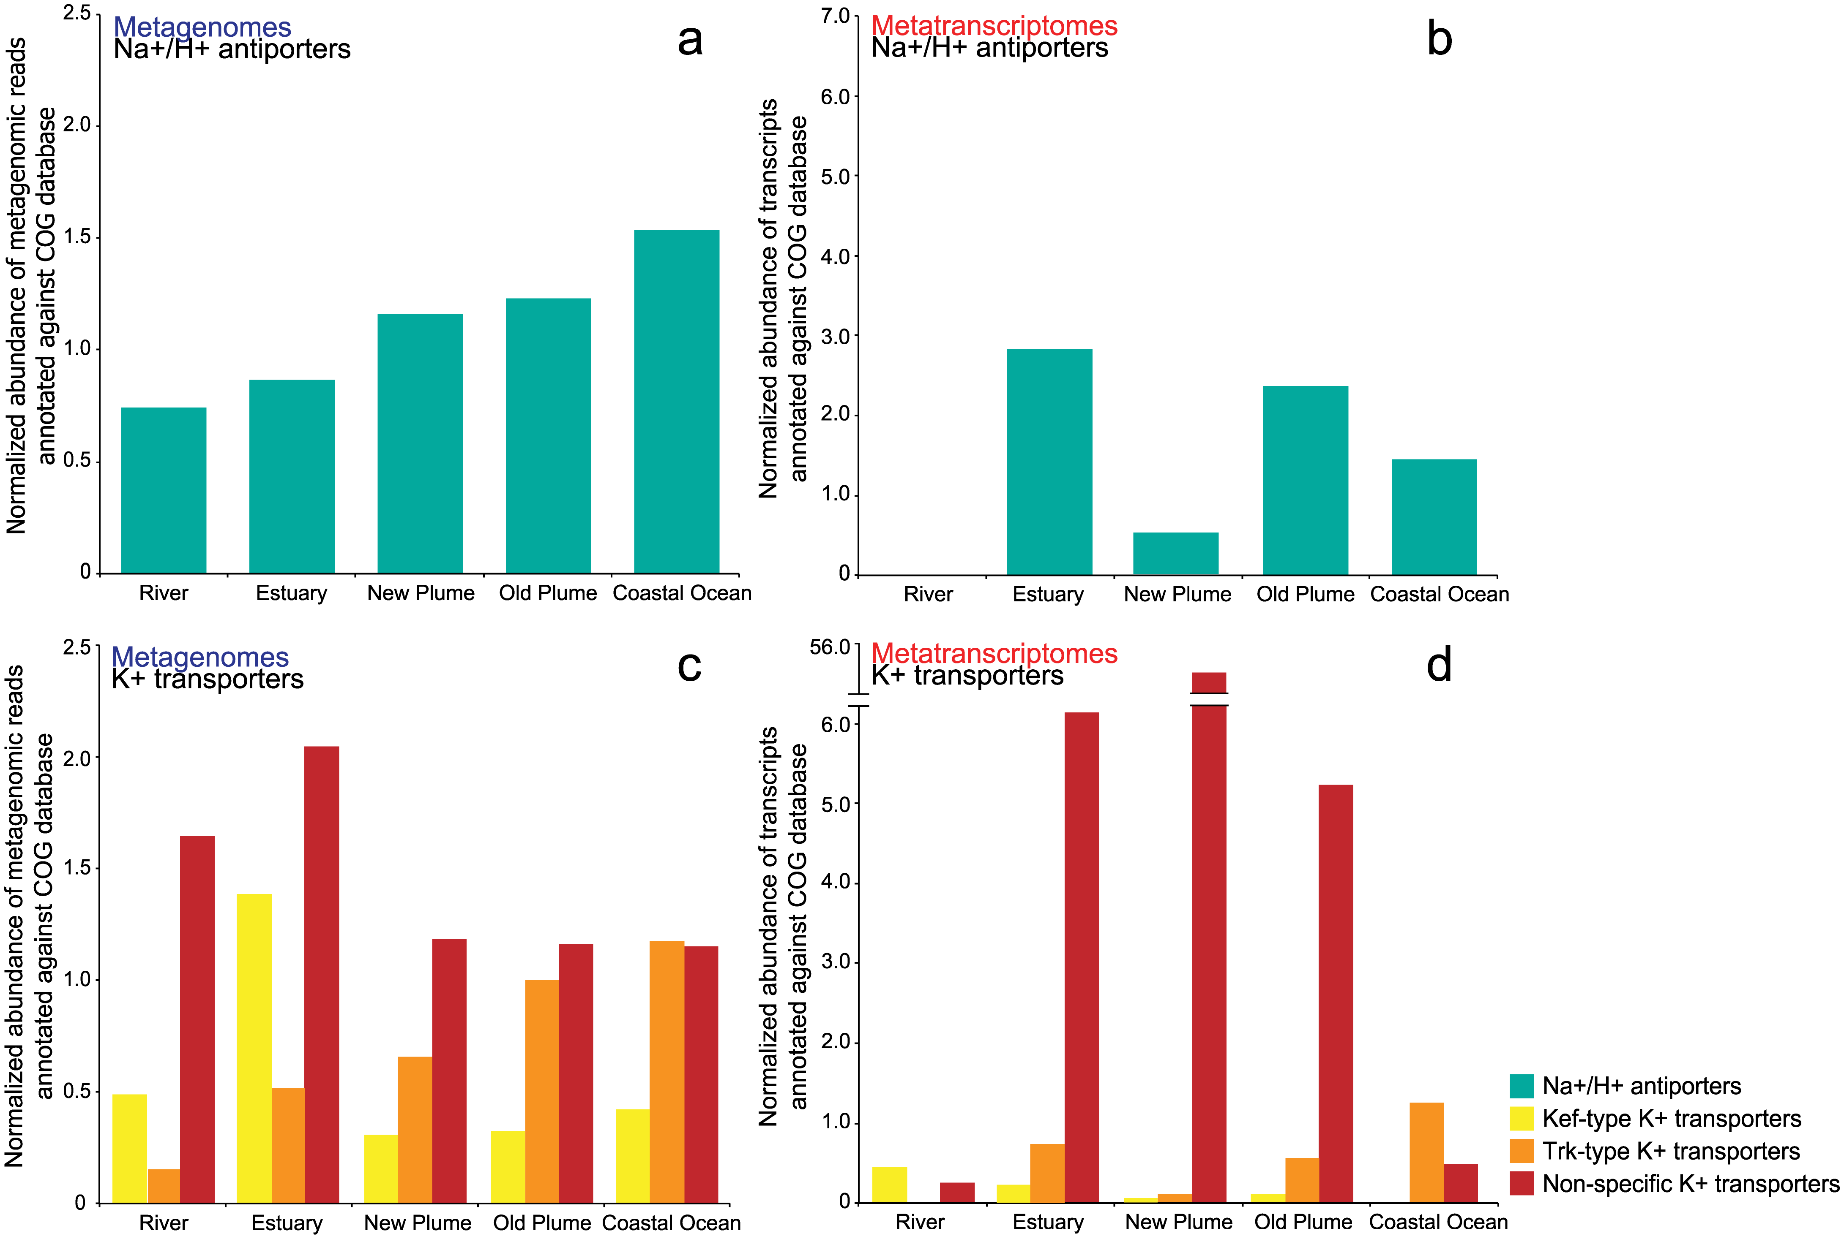
What is metatranscriptomics?
FUNCTION: Which genes and pathways are actively expressed within a community
TAXONOMY: Which taxa are responsible for the metabolic activity BUT NOT WHO IS THERE
Metabolic potential - highly similar across samples (with few differences in functional gene abundance from river to ocean)
Gene expression - highly variable and generally was independent of changes in salinity
Fortunato et al. 2015 PLOS ONE

Slide 6
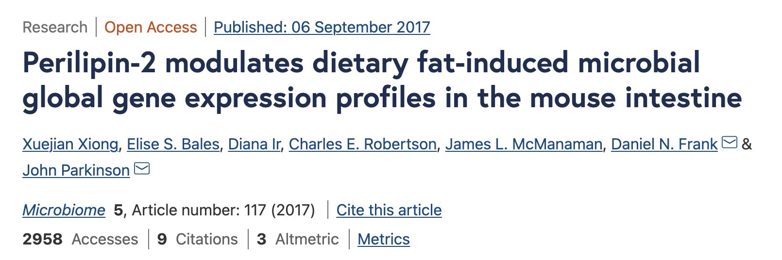


















EXAMPLE
Plin2 (Perilipin2) – involved in lipid uptake, interacts with lipid droplets
Study comparing WT and Plin2-null mice - exposure to high-fat/low-carb (HF) or low-fat/high-carb (LF) diets
Genotype
Diet
Wild type
Plin2-KO
RNA-Seq
20-30 million sequence reads/mouse
Xiong et al. 2017 BMC Microbiome

Slide 7
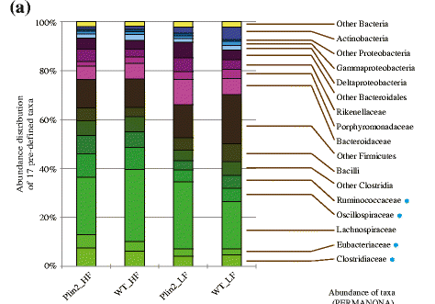

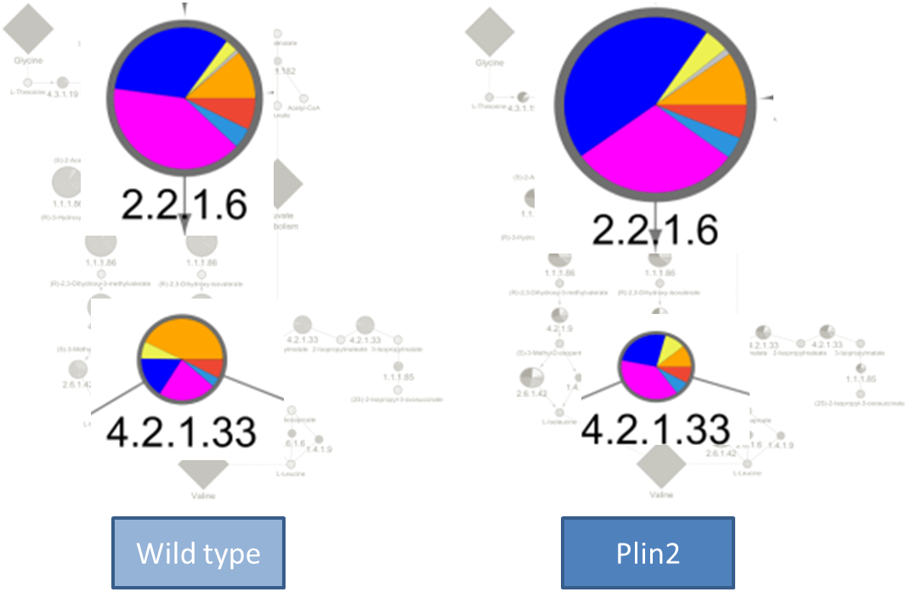


EXAMPLE
Perilipin2 KO mice fed a high fat diet exhibited a similar microbiome as WT mice fed the same diet….
Acetolactate synthatse
…however metabolic pathways are differentially expressed – host genotype impacts microbiome function
Isopropylmalate isomerase
Xiong et al. 2017 BMC Microbiome

Slide 8
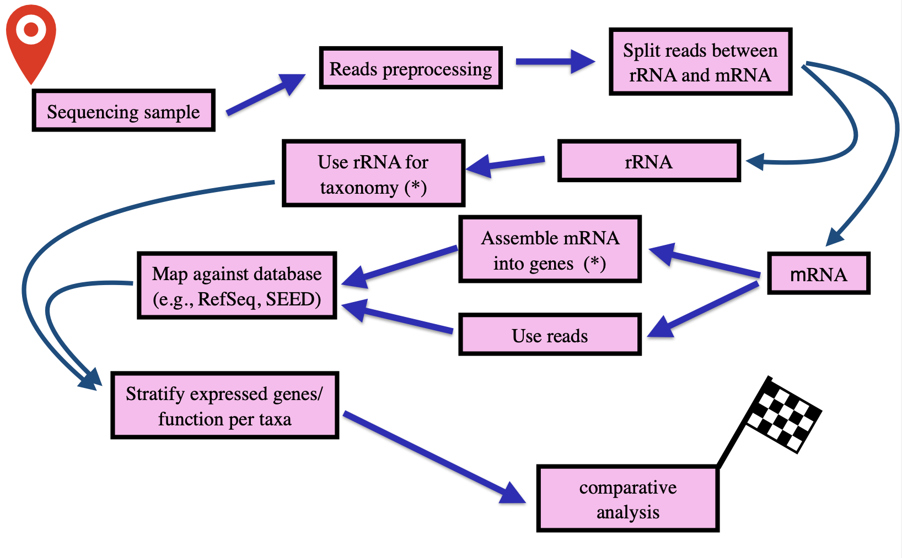
WORKFLOW
!
Notes:
Mention that traditional rnaseq is different

Slide 9
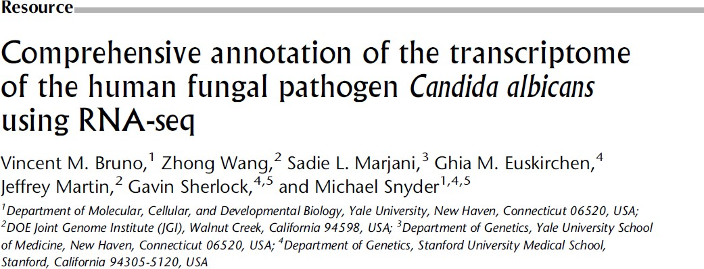
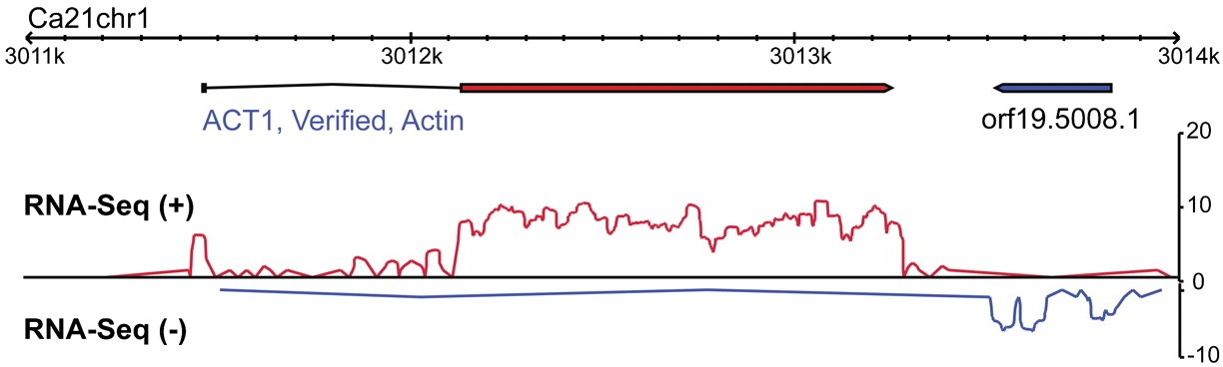
CHALLENGES
In a typical RNA-Seq experiment applied to a single eukaryotic organism, mRNA is isolated. After fragmentation and sequencing, reads are mapped to a reference genome using standard software such as BWA and STAR to provide: 1) support that the transcript is expressed; 2) the relative abundance of the transcript; and 3) the presence and abundance of isoforms
For microbiome samples we have the following problems:
Lack of a polyA signal makes it difficult to isolate bacterial mRNA and resulting in (massive) rRNA contamination
Environmental microbiome samples lack reference genomes making it difficult to map reads back to their source transcripts
Host contamination
https://bioinformatics.ca/

Slide 10

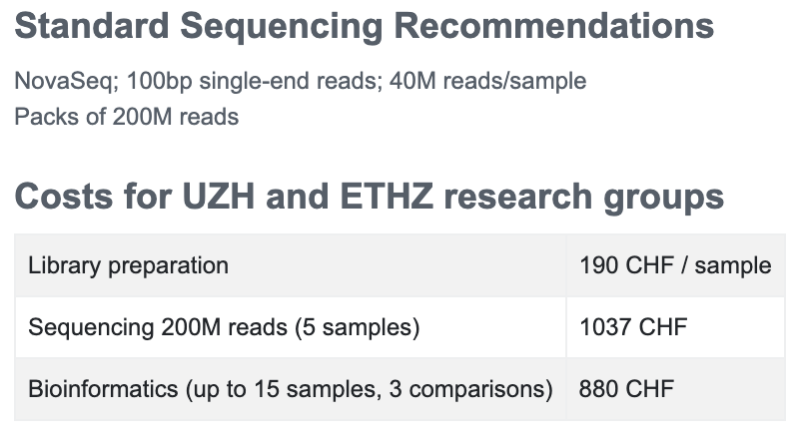
CHALLENGES
RNA quality deteriorates rapidly – Method of storage and preparation can impact taxa recovered and has yet to be standardized
Best(?): Process immediately to extract RNA then store at -80 Next best(?): Snap freeze in liquid nitrogen and store at -80
Avoid use of RNALater – it lyses some cells and can interfere with RNA extraction kits (e.g Ambion RiboPure Bacteria Kit / LifeTech Trizol Plus)
Number of biological replicates
At least 2!
Power analyses challenging
https://bioinformatics.ca/

Slide 11
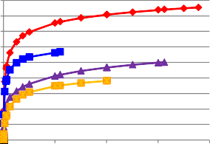
HOW MANY READS IS ENOUGH
https://bioinformatics.ca/
1800
1600
1400
1200
1000
800
600
400
200
0
deepsea kimchi mouse cow
Number of ECs
0 2000000 4000000 6000000 8000000
Number of Reads
~5 million mRNA reads provide 90-95% of ECs in a microbiome
With kits yielding mRNA read rates of ~25%, this suggests 20 million/sample mRNA

Slide 12
WORKFLOW
!
Notes:
Mention that traditional rnaseq is different

Slide 13
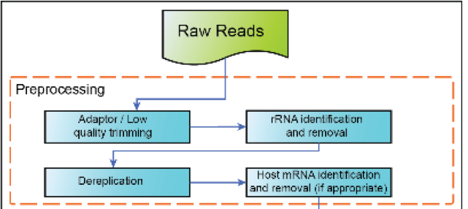
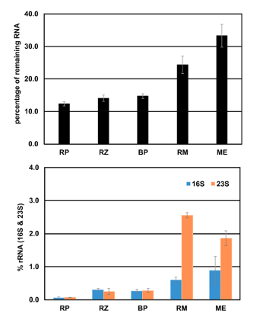
Preprocessing
Trimmomatic - removal of:
low quality
Adaptors
BWA/BLAT – alignment of reads to (and removal)
Host transcriptome
rRNA databases
SortMeRNA/Infernal – removal of rRNA
(A) Percentage of remaining RNA afer depletion using the diferent depletion kits compared. Te
input of 2.5 µg total RNA was set to 100%.
(B) Remaining 16S and 23S rRNA afer depletion with the diferent
kits compared to the untreated RNA determined by the Bioanalyzer electropherograms. RP, riboPOOLs; RZ,
RiboZero; BP, biotinylated probes; RM, RiboMinus; ME, MICROBExpress.
Module 6
Wahl et al. 2022

Slide 14
WORKFLOW
!
Notes:
Mention that traditional rnaseq is different

Slide 15
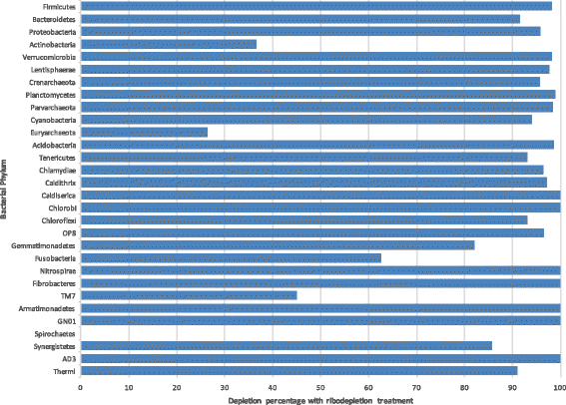
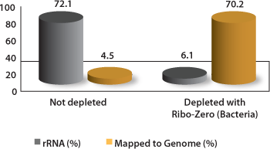
rRNA
Reads assigned to the rRNA database can be used for taxonomic classification
BUT VERY OFTEN rRNA DEPLETION KITS ARE USED BEFORE EXTRACTION
Not all species are equally depleted
Westreich et al. BMC Bioinformatics 2016

Slide 16
WORKFLOW
!
Notes:
Mention that traditional rnaseq is different

Slide 17
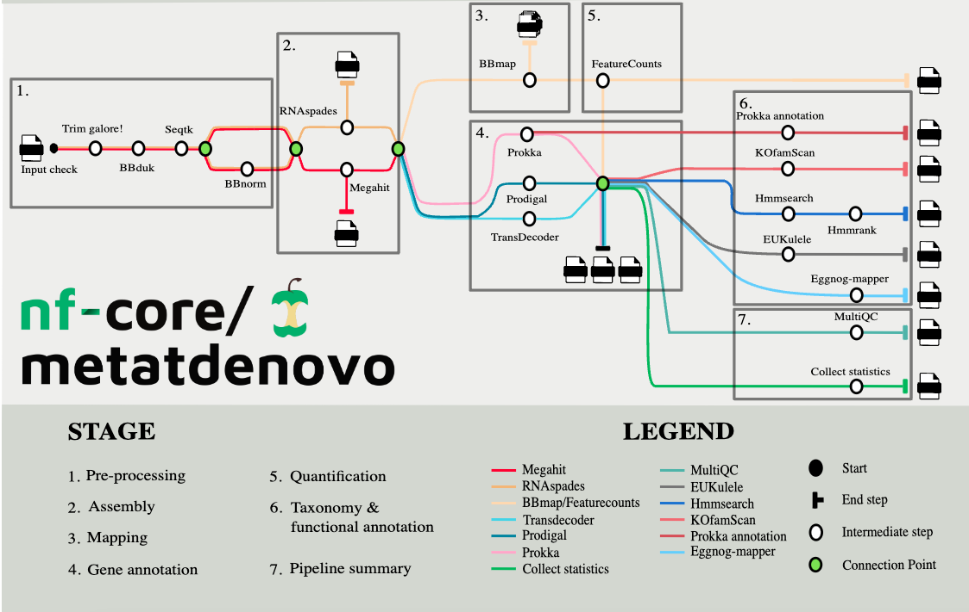
ASSEMBLY BASED

Slide 18
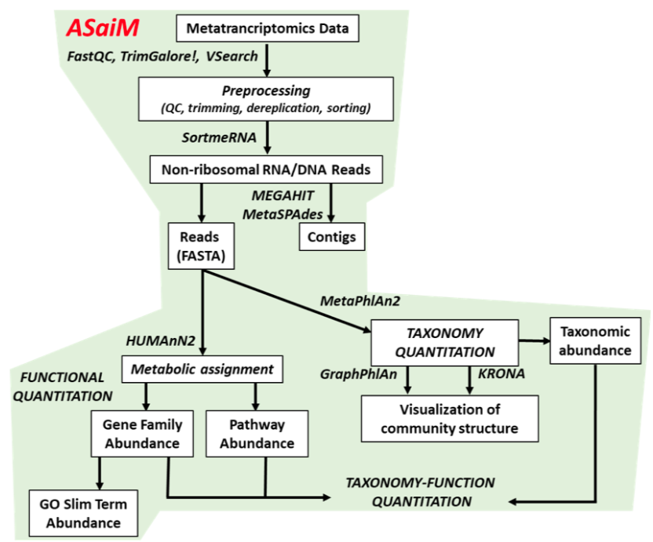
ASSEMBLY BASED
https://training.galaxyproject.org/training-material/topics/microbiome/tutorials/metatranscriptomics/tutorial.html

Slide 19
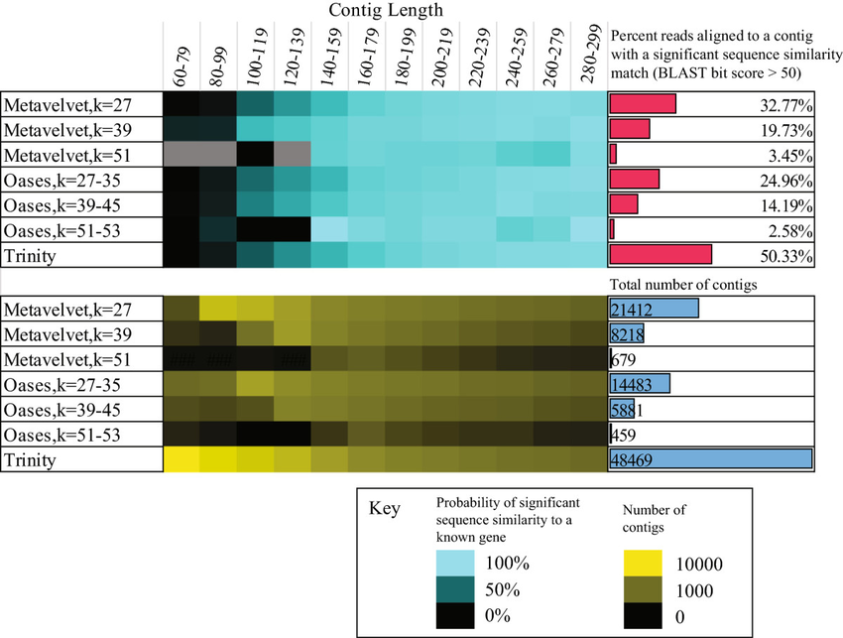
ASSEMBLY
Reads can be assembled de novo into genes
Assembly improves annotation accuracy
Originally Trinity was used but now Spades
Pros:
splicing better handled for eukaryotes
Cons:
time consuming,
computationally intensive,
hardly needed for bacteria
Chimeras, missasembled contigs – there are tools for identification of those
data
contig1
contig2
Celaj et al. 2014 Microbiome

Slide 20
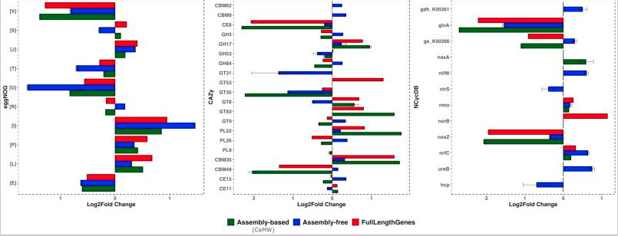
ASSEMBLY
Assembly free and assembly based methods don’t always agree
Differential expression of functional categories between 2 simulated microbial communities annotated with 3 different databases
Anwar et al. 2019. GigaScience

Slide 21
WORKFLOW
!
Notes:
Mention that traditional rnaseq is different

Slide 22
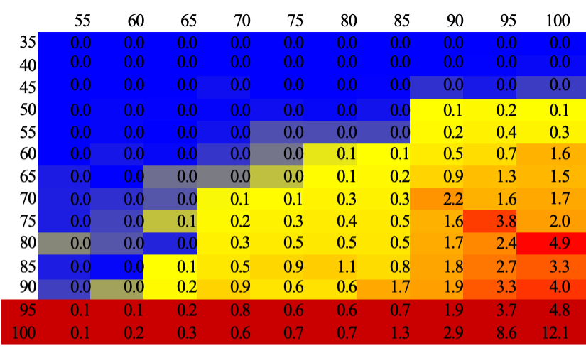
Annotation with databases
Relies on sequence similarity searches with tools such as BLAT, BLAST, BWA
BWA, BLAT – rely on near perfect matches
Local alignment with Smith-Waterman algorithm
BLAST – very time consuming → Diamond – in a blastx mode, much faster
Summary of BLASTX matches for a mouse metatranscriptome
% of Read Length
You want to filter based on % of read length but also % ID of match
MANY READS STILL COME OUT UNANNOTATED
% ID of match

Slide 23
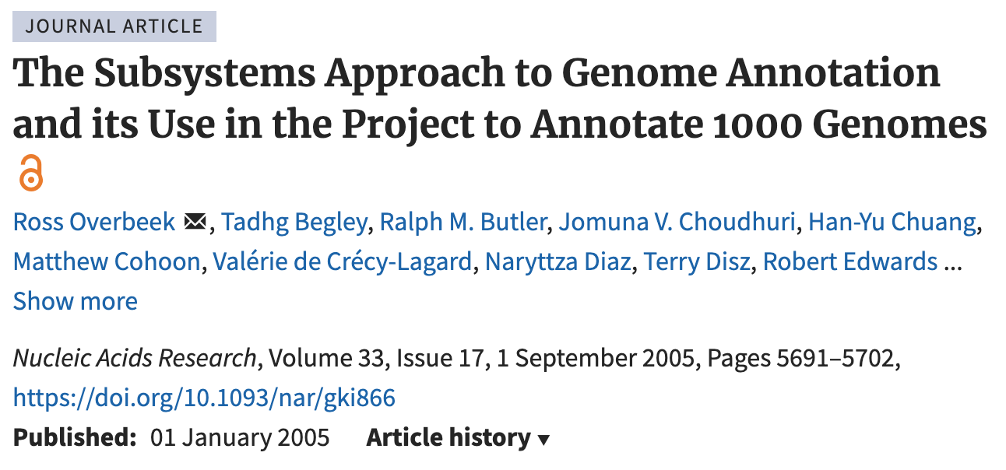
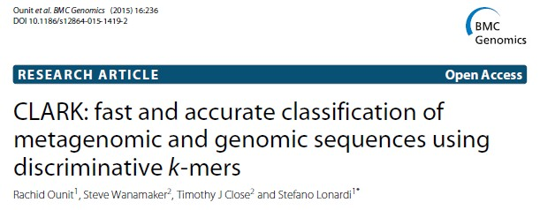
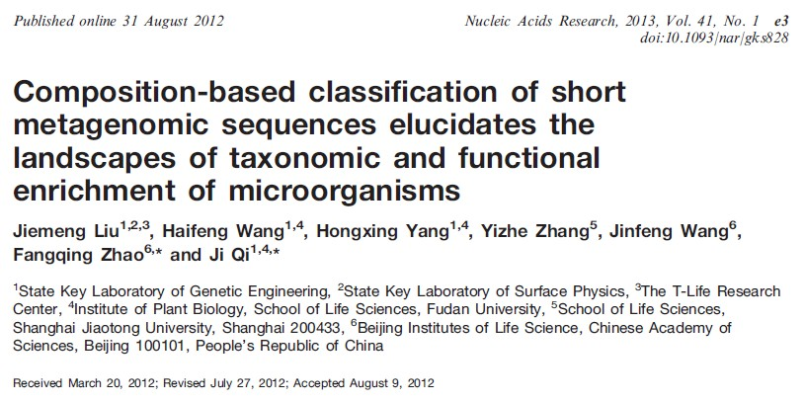
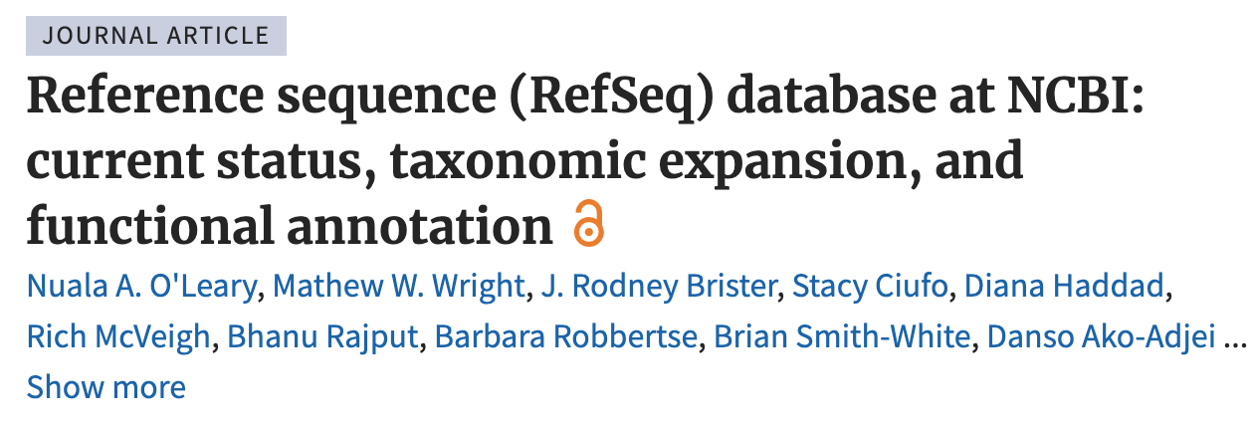
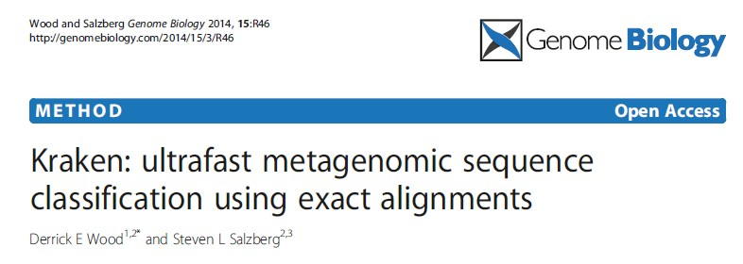
Annotation with databases - taxonomy
Assigning RNA reads to taxa might reveal which critical functions are associated with whom
It could also help binning for the assembly.
Subsystems
CLARK - 2015
NBC - 2011
RefSeq NCBI
KRAKEN - 2014

Slide 24
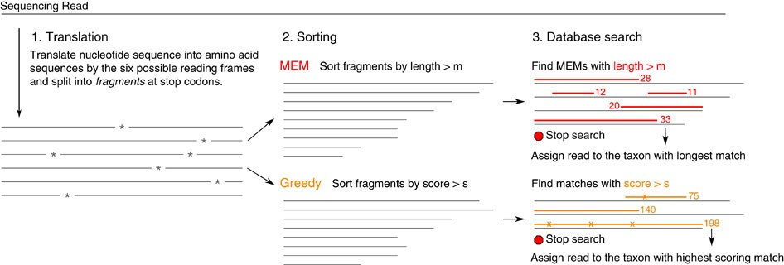
Annotation with databases - taxonomy
How Kraken works already mentioned
Mapping to Refseq or Subsystems done with Diamond (blastx type of search)
A lot of the methods work on Nearest Neighbour to assign sequence to the genome
Kaiju is based on Burrows Wheeler Transform (BWT) and also uses a database e.g. RefSeq
Fast
Accounts for sequencing errors
Needs large amount of memory
Features a GUI to explore results

Slide 25
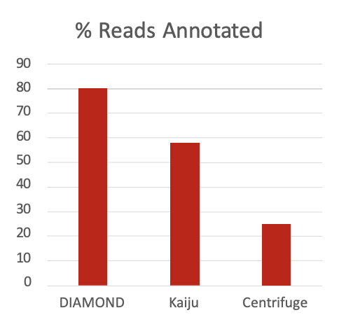
Annotation with databases - taxonomy
Diamond used in standardized workflows
For a SPF mouse gut microbiome – DIAMOND annotates most reads

Slide 26
WORKFLOW
!
Notes:
Mention that traditional rnaseq is different

Slide 27


Mappings -> gene expression
To normalize expression to account for differences in gene length - read counts are converted to Reads per kilobase of transcript mapped (RPKM)
Longer transcripts should have more reads mapping to them
RPKM_{geneA} = 10⁹ C_{geneA} / NL
C_{geneA} = number of reads mapped to geneA
N = total number of reads
L = length of transcript in units of Kb
# 8
24
8
1
6
12
Several softwares are available to do mapping and calculate normalized expression measurements across different samples including Bowtie and Cufflinks
But also implemented in several standardized workflows

Slide 28
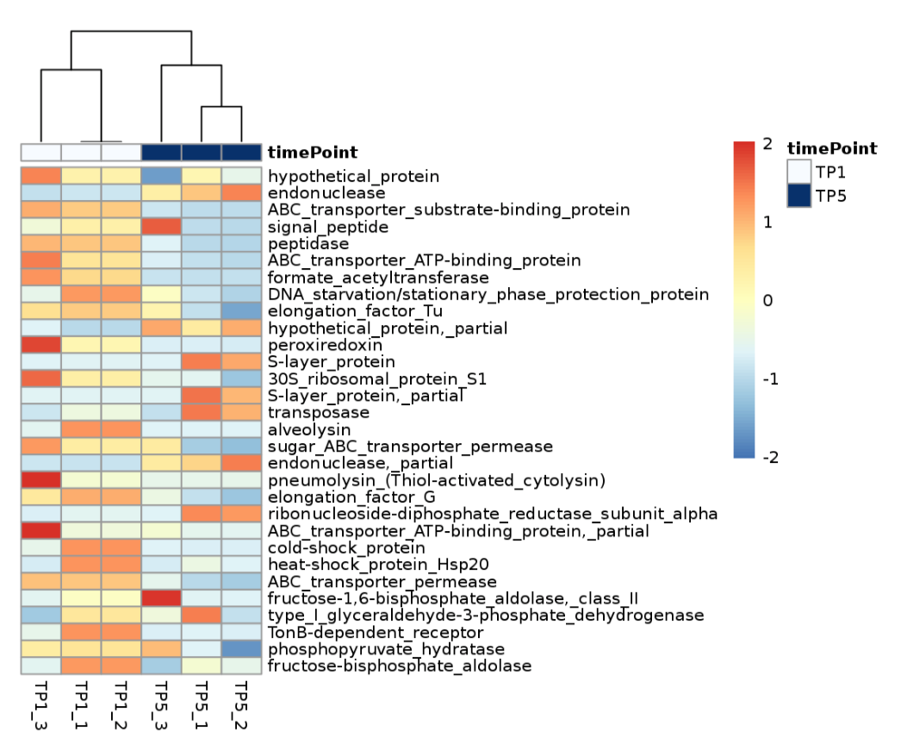
Functional annotation/stratification
Mapping transcripts to more general functions
Gene Ontology Annotation can help statify functions assigned to transcripts: EggNOG, OMA, Pannzer2
Mapping transcripts into more general functions – transcripts might not be important but might code for similar functions

Slide 29
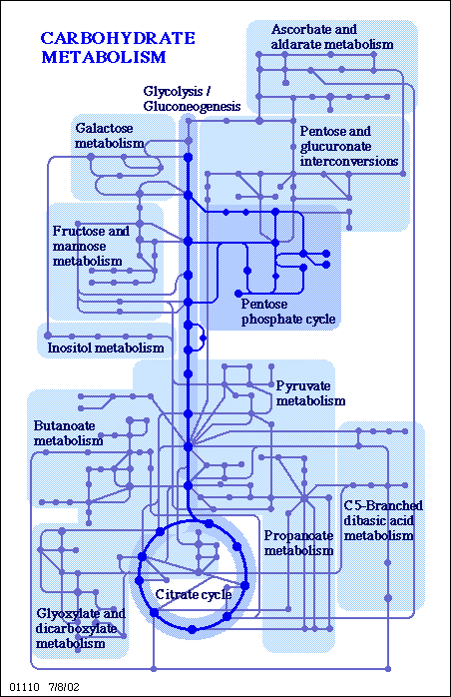
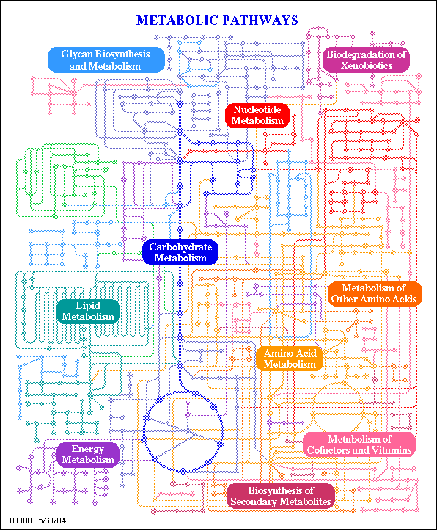
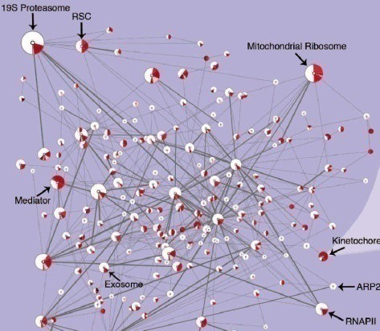
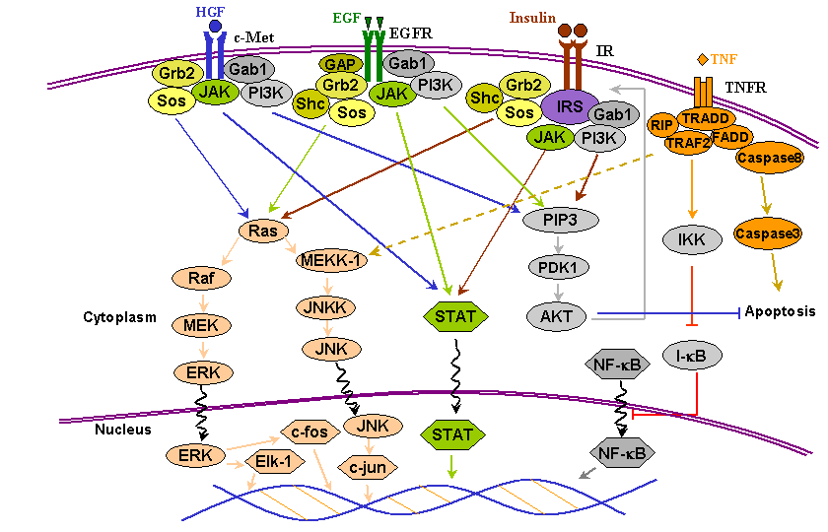
Functional categories
Genes and proteins form parts of interconnected functional modules
Grouping gene functions into larger categories can help explain which metabolic processes are most important in the sample/ different between samples.
RPKM_{geneA} = 10⁹ C_{geneA} / NL
Protein complexes
Metabolic pathways
Signalling pathways
InterProScan
UniProt
KEGG
KEGG/IPath
bioinformatics.ca

Slide 30
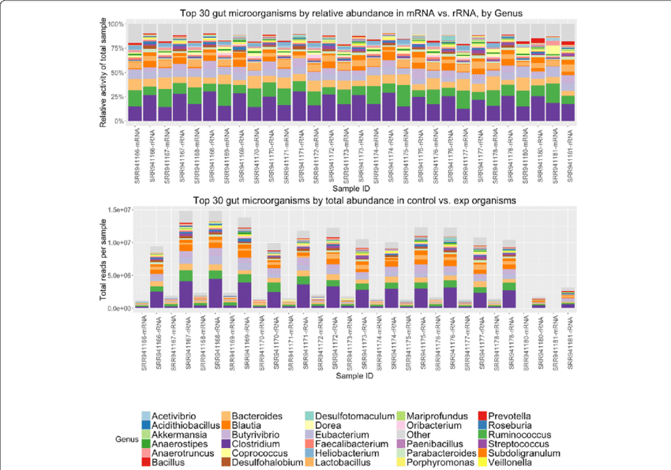
Taxonomy from mRNA expression $≠$ rRNA abundance
Comparison of mRNA vs. rRNA based abundance estimates
Abundance not the same as expression!!
Differences can be subtle but also can be big
Westreich et al 2016

Slide 31
WORKFLOW
!
Notes:
Mention that traditional rnaseq is different

Slide 32
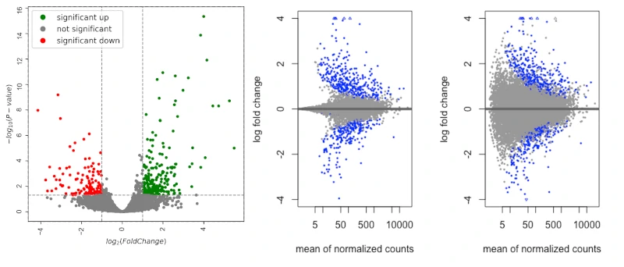
Statistical/ comparative analysis
DESeq2 takes in a count table
Normalisation
geometric mean is calculated for each gene across all samples,
counts for a gene in each sample is divided by this mean,
median of these ratios in a sample is the size factor for that sample
Variance estimation (dispersion and fold changes)
within-group variance calculated between replicates
shrinkage estimation for dispersions and fold changes
dispersion value is estimated for each gene through a model fit procedure.
Differential expression
negative binomial generalized linear models fitting for each gene and the Wald test for significance testing
Notes:
PCA, Deseq2 – how it works, This procedure corrects for library size and RNA composition bias, which can arise for example when only a small number of genes are very highly expressed in one experiment condition but not in the other.

Slide 33
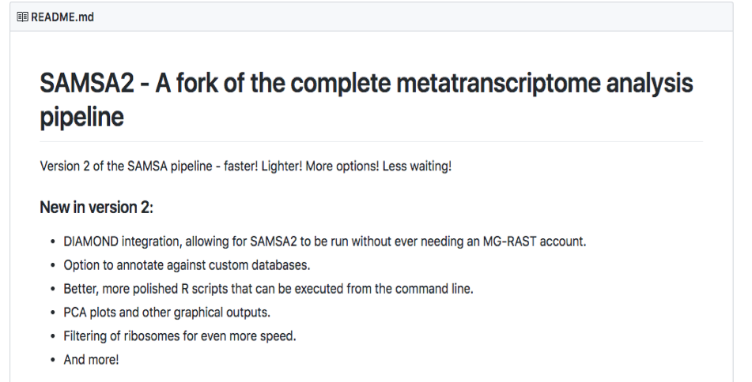
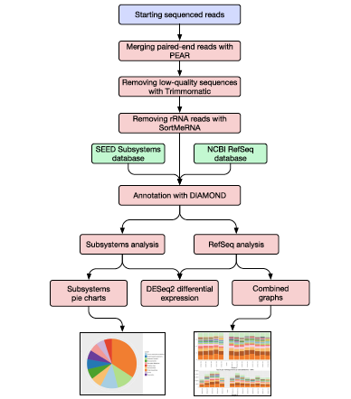
Samsa2 (https://github.com/transcript/samsa2
Remarks
All tools nicely wrapped up

Slide 34
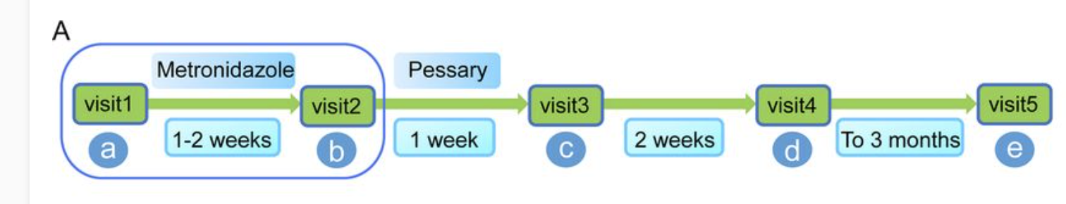
Tutorial – Bacterial Vaginosis
multifactorial disease characterized by a shift from the Lactobacillus species-dominated microbial community toward a taxonomically diverse anaerobic community
8 women diagnosed with BV
4 successfully treated, 4 not
Paired-end seq performed on a HiSeq 2500 Sequencer to yield 2 × 110-bp
https://journals.asm.org/doi/full/10.1128/mSphereDirect.00262-18

